Slide 1
6.FILE:-
This filed is used to include more than one file while submitting the form.
After the form is processed the given files are stored into the disk of the web server.
That is the reason file input is often known as “File Upload”.
Example:
<input type=”file”>

Slide 2
Example:
<html>
<head>
<title>Demo on Text Box </title>
</head>
<body>
<form>
Upload a File :
<input type="file">
</form>
</body>
</html>

Slide 3
7.IMAGE:-
The input element, having the "image" value in its type attribute, represents a graphical submit button, which is a regular image that when pressed, submits the form it belongs to.
Example:
<input type="image" src="img.jpg" alt="Submit" width="100" height="100">

Slide 4
Example:
<html>
<head>
<title>Demo on Text Box </title>
</head>
<body>
<form>
<input type="image" src="img.jpg" alt="Submit" width="100" height="100">
</form>
</body>
</html>

Slide 5
2. SELECT:-
The select tag allows to choose any subset of items from a group by using select tag<SELECT> with corresponding ending tag</SELECT>.
The radio button and checkboxes will occupy a lot of screen space where as select tag does not take.
The items in a given select tag are usually rendered in the style of a pop-up menu, indicated with in <OPTION></OPTION> tag. The closing tag is optional.

Slide 6
Example:
Select your Branch:
<select name=”branch”>
<option> Bsc
<option> BCA
<option> BCom
<option> BBC
<option> BBA
</select>

Slide 7
Example:
<html>
<head>
<title>Demo on Text Box </title>
</head>
<body>
<form>
Select your Branch:<br>
<select name="branch">
<option> Select
<option> Bsc
<option> BCA
<option> BCom
<option> BBC
<option> BBA
</select>
</form>
</body>
</html>

Slide 8
You can create a group element so that the multiple blocks for multiple sub items can be created by using <optgroup ></optgroup> tag
Example:
Select your Branch: <br>
<select name="branch">
<option>Select
<optgroup label="BSc">
<option value="mpcs">MPCS
<option value="mscs">MSCS
<option value="mecs">MECS
</optgroup>
<optgroup label="BCom">
<option value="general">General
<option value="computers">Computers
</optgroup>
</select>

Slide 9
3. TEXTAREA:
The <textarea> tag defines a multi-line text input control. A text area can hold any number of characters, and the text renders in a fixed width font.
The size of a text area can be specified by the cols and rows attributes.
Example:-
<textarea name=”address” rows=”20” cols=”80” maxlength=”2000” wrap>
Enter Text to be displayed.
</textarea>

Slide 10
Example:
<html>
<head>
<title>Demo on Text Box </title>
</head>
<body>
<form>
<textarea name="address" rows="10" cols="40" maxlength="1000" wrap>
Enter Text to be displayed.
</textarea>
</form>
</body>
</html>

Slide 11
4. FILEDSET:-
<FILEDSET> and <LEGEND> are used to draw the border for the specified form with a title in order to identify each form separately in a single web page.
<FIELDSET>
<LEGEND>Personal Information<LEGEND>
</FILEDSET>

Slide 12
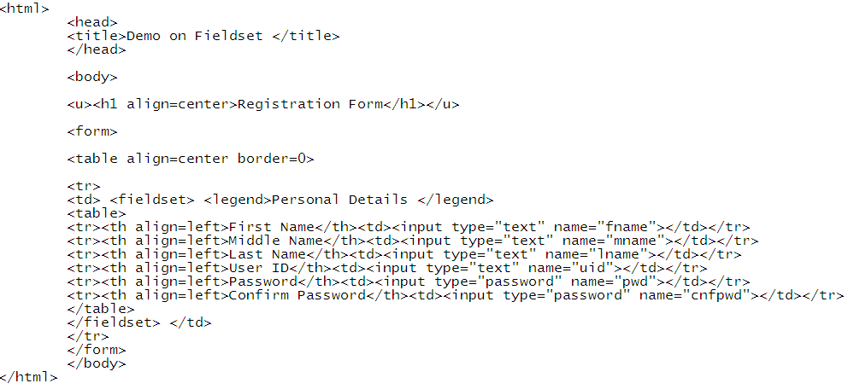
Example:

Slide 13
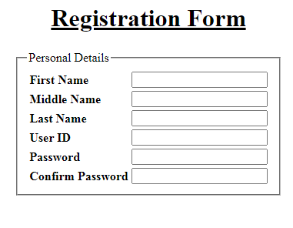
Output:

Slide 14
Design User Registration Form

